Slide 1
CSP/Math 571 Lecture 1
Adam McElhinney

Slide 2
Agenda
Course overview
What is Data Science?
Overview
Key Vocabulary
DS Common tools
Data Science Process
Introduction to R

Slide 3
Course Overview

Slide 4
Instructor
Adam McElhinney
Educational Background
Professional Background
Contact
adam.m.mcelhinney@gmail.com
Office hours
Monday, 5 - 6:15 PM and by appointment

Slide 5
Course Objectives
Discuss the concepts of data science Gain familiarity with the typical steps of a data science project Gather requirements for data analysis projects Quickly prepare data for analysis Programmatically analyze data Develop meaningful data visualizations Explore case studies Examine ethical issues in data science Report on findings of their analysis Develop and present analysis effectively Prepare students for future classes in the MAS-DSC program Prepare students for their capstone project

Slide 6
Course Objectives...
Cumulative course content
Course “phases”
Phase 1
Weeks 1 - 4
Objectives
Overview of DS process and vocabulary
Basic R proficiency
Ability to “get a sense” of a data set

Slide 7
Course Objectives...
Course “phases”
Phase 2
Weeks 5 - 7
Objectives
Thorough understanding of data preprocessing
Deeper understanding of R
Introduction to modeling and analysis concepts

Slide 8
Course Objectives...
Course “phases”
Phase 3
Weeks 8 - 13
Objectives
Thorough understanding of modeling techniques
MORE proficiency with R and data analysis programming

Slide 9
Course Objectives...
Course “phases”
Phase 4
Weeks 14 - 17
Objectives
Advanced data analysis techniques
Programming for data analysis best practices
Additional data analysis toolsets
“Bringing it all together” (problem identification through analysis through delivery and presentation)

Slide 10
Grading
See syllabus

Slide 11
Collaboration
See syllabus

Slide 12
What is Data Science?

Slide 13
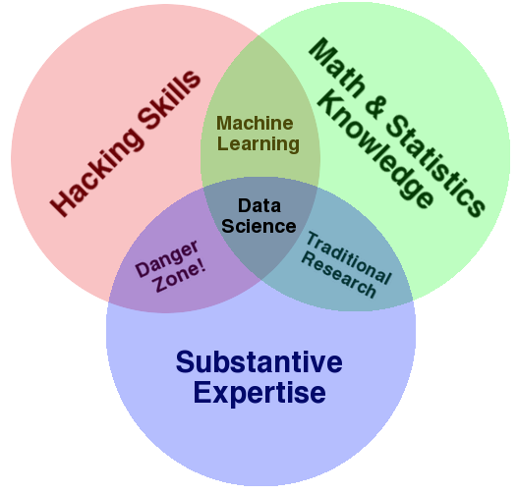
What is Data Science?
What are “hacking skills”?
What types of math and statistics knowledge is required?
What is substantive expertise?
Why is the interaction of hacking skills and substantive expertise called “Danger Zone!”?

Slide 14
Examples of Some “Data Science” Projects
Determine which customers are most likely to repay a loan.
Help an online retailer determine the optimal coupon amount and timing.
Assist a railroad company in reducing unplanned downtime by predicting machine failures before they occur.
Recommend which models of cars a rental car company should purchase to optimize profits

Slide 15
“Big Data”
4 V’s of Big Data
Volume: Amount of data (diskspace)
Variety
Structured versus unstructured
New data sources
Sensors
Social media
Veracity: Trustworthiness
Velocity
Real-time versus batch
Value: How does the data actually impact your organization

Slide 16
“Big data” versus “wide data”
As additional variables are collected, data sets become “wide”
Poises additional problems for the analyst

Slide 17
Prediction versus Causality
Machine learning can tell you associations, NOT causality
What is the impact of this in the real-world?

Slide 18
Feature Extraction
Unaltered data sets are typically referred to as “raw data”
Features are combinations of various raw variables
Age range
Income bracket
Music genre
Features can be “extracted” in a variety of ways
Domain experts
Clustering techniques
Topical analysis

Slide 19
Regularization
Regularization: Process to determine how features should be included or weighted in your final model to avoid overfitting.
Pruning and Selection: Figure out what features contain the best signal and discard the rest.
Shrinkage: Reduce the influence of some features to avoid overfitting.

Slide 20
Over-fitting
Over-fitting: Building a model based on patterns that will not hold up in future cases

Slide 21
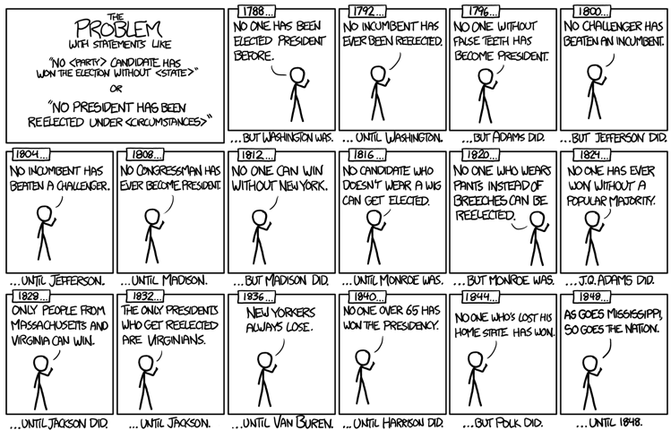
Over-fitting...
Xkcd

Slide 22
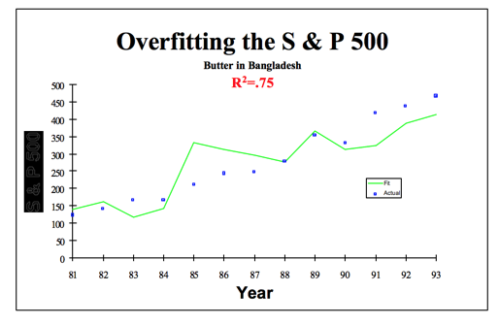
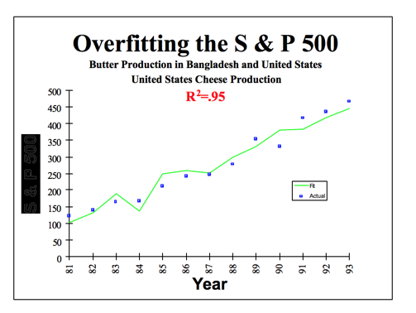
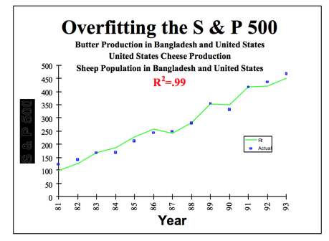
Overfitting...
STUPID DATA MINER TRICKS

Slide 23
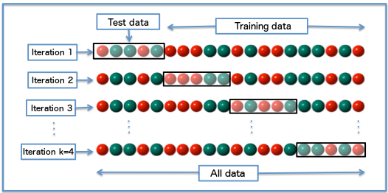
Cross-Validation
Technique to determine whether or model is making good predictions by simulating “out of sample” tests
Models are built and evaluated on different data sets
Helps to avoid overfitting and build models that are hopefully generalizable

Slide 24
“Out of sample” versus “Out of context”
Out of sample performance: if we collect data from the exact same environment, the model will be able to predict outcomes with the same degree of performance
Out of context performance: if we build a model to predict outcomes in one environment, will the model be able to predict outcomes in a different environment
Online versus brick and mortar
Holiday shopping patterns versus rest of year shopping patterns

Slide 25
Data Science Project Process

Slide 26
Steps for DS Projects
Problem definition and planning
Data preparation
Analysis
Deployment

Slide 27
Problem Definition and Planning
Components of problem definition and planning
Identify problem
List projects deliverables
Generate success factors
Understand each resource and other limitations
Put together appropriate team
Create a plan
Perform a costs/benefits analysis

Slide 28
Data Preparation
Components of data preparation
Access and combine data tables
Summarize data
Look for errors
Transform data
Segment data

Slide 29
Analysis
Components of analysis
Summarizing data
Exploring relationships between attributes
Grouping the data
Identifying non-trivial facts, patterns and trends
Building regression models
Building classification models

Slide 30
Deployment
Components of deployment
Generate report
Deploy standalone or integrated decision support tool
Measure business impact

Slide 31
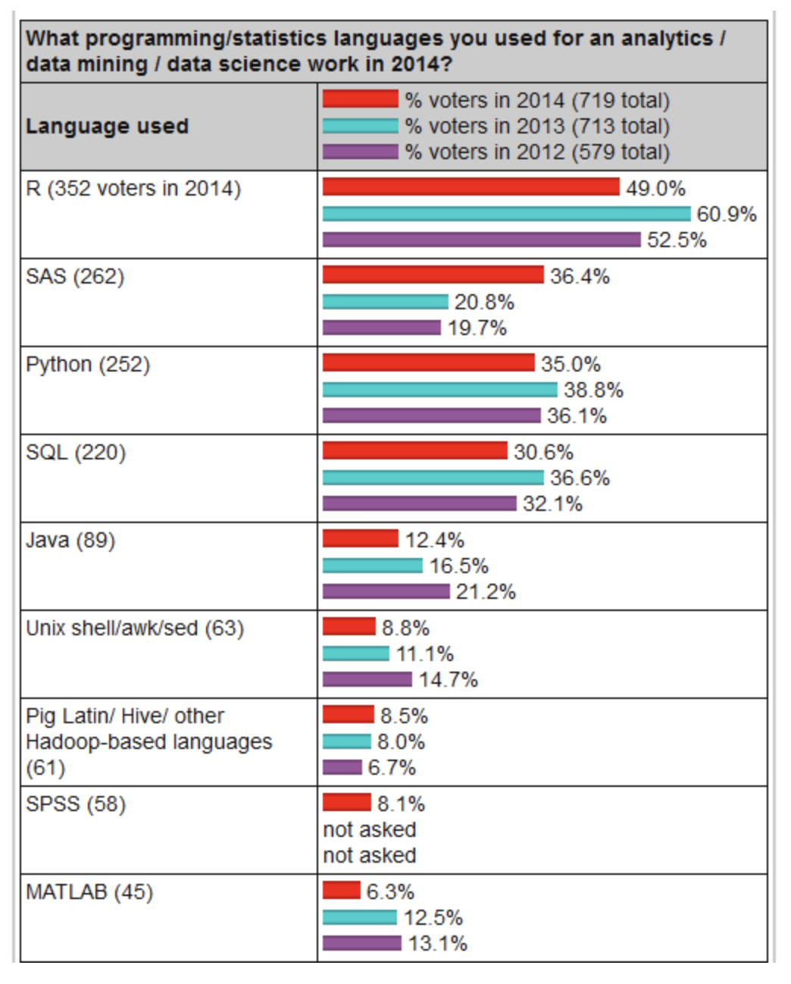
What languages are used for Data Science?
Python and R most popular
Open source
Gaining traction
SAS most popular commercial language
Popular in pharma and some areas of finance
Command line tools are extremely ubiquitous
Notes:
Image source: http://bigdata-madesimple.com/how-i-chose-the-right-programming-language-for-data-science/

Slide 32
Introduction to R

Slide 33
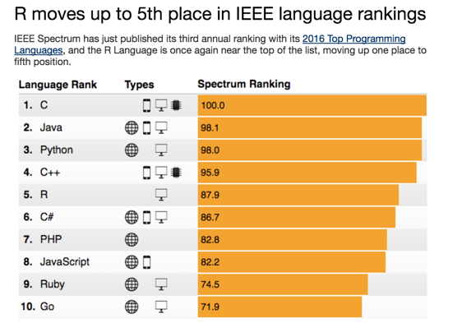
Introduction to R
R and Python are the most popular languages for data science

Slide 34
Introduction to R
Successor to a language called S
Developed at Bell Labs
R formalized by Ross Ihaka and Robert Gentlemen at University of Auckland
Interpreted language
Dynamically typed
Capabilities extended by packages (~8000 available)
Packages and R are distributed through the Comprehensive R Archive Network (CRAN)
Provides easy bindings to languages such at C, Java and Python

Slide 35
This Course
Primarily will be taught in R
Will also leverage
Command line tools
C++
Python
Others if time!

